Slide 1


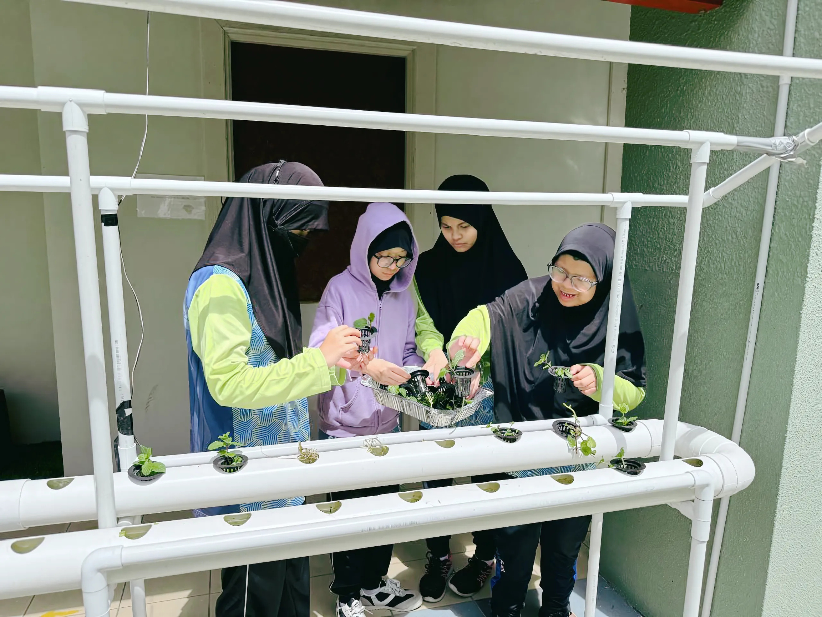


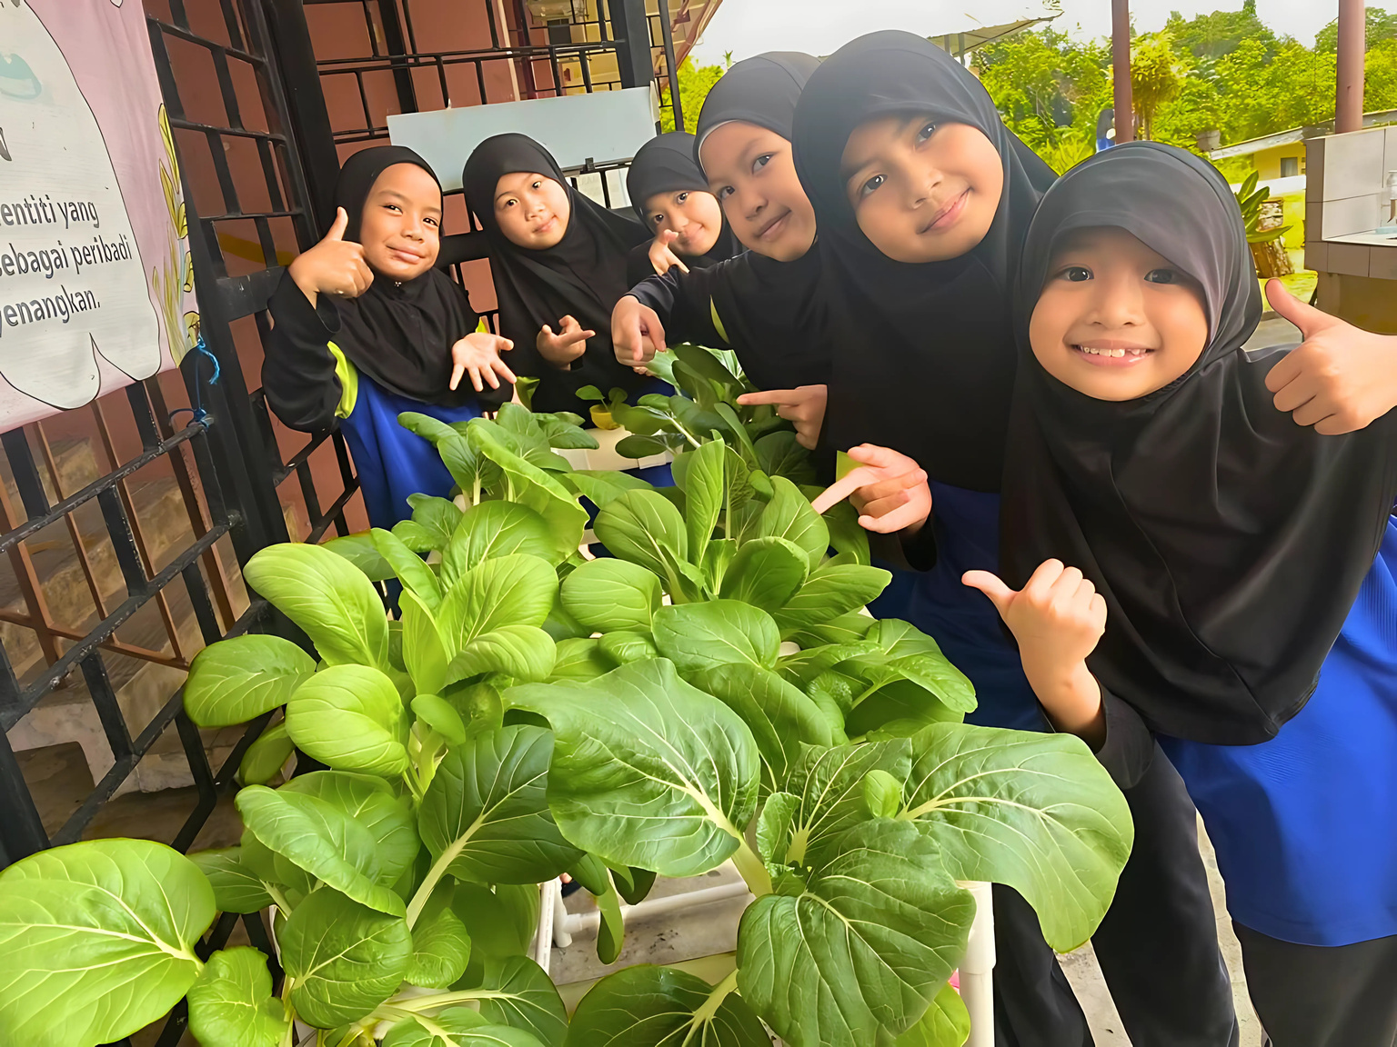
reening
E
P
lan
ducation
2025-2035

Slide 2












TABLE OF CONTENTS
1
2
Introduction
Titah Excerpts
4
Strategic Framework
  Vision and Mission
  Focus Area
  Strategic Pillars
  Cross-Cutting Enablers
3
Objectives
5
6
Implementation Strategy
  Green Curriculum and Co-Curriculum
  Green Career Pathways
  Green Infrastructure
  Research and Innovation
  Eco-Friendly Practices
Key Enablers
  Capacity Building
  Monitoring and Evaluation
  Stakeholder Engagement and Collaboration
  Technology Integration
  Governance and Finance

Slide 3


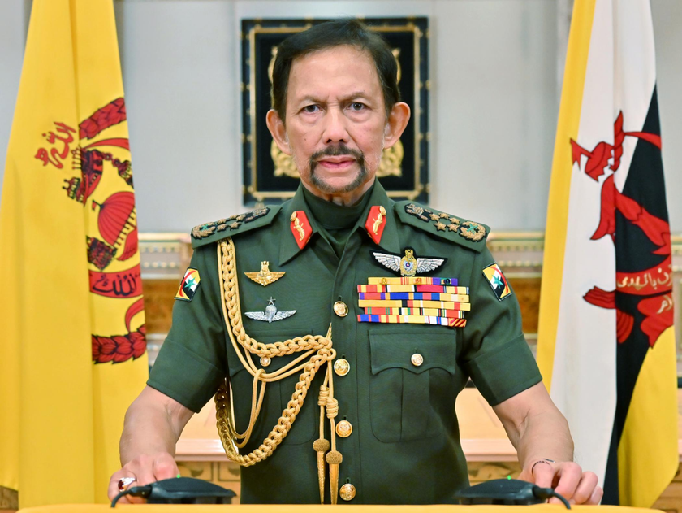


INTRODUCTION
TITAH EXPERPTS
His Majesty Sultan Haji Hassanal Bolkiah Mu'izzaddin Waddaulah
ibni Al-Marhum Sultan Haji Omar 'Ali Saifuddien Sa'adul Khairi Waddien Sultan and Yang Di-Pertuan of Brunei Darussalam
“The nation will continue to prioritise efforts at the global level that relate to climate change. In relation to this, the establishment of the Brunei Darussalam National Climate Change Policy (BNCCP) and the country’s appointment as the Host of the ASEAN Centre for Climate Change, are some manifestations of the aforementioned commitments.”
Titah in conjunction with New Year 2024
“Regarding climate change, we have given consent to the Brunei Darussalam Climate Change Policy (BNCCP), which outlines 10 strategies to reduce greenhouse gas emissions and pave the way for Brunei Darussalam to become a low-carbon and climate-resilient nation.”
“Negara Brunei Darussalam has reduced its annual greenhouse gas emissions and will continue to cut emissions by 20% by 2030, in line with commitments under the Paris Agreement. It has also pledged to achieve net-zero emissions by 2025.”
Titah in conjunction with His Majesty’s 77th Birthday Celebration 1444H/2023M
01

Slide 4

INTRODUCTION
INTRODUCTION
The Greening Education Plan (GEP) is Brunei Darussalam’s roadmap to make education a driving force for a sustainable future.
It aims to build schools, institutions and communities that live by green values of reducing waste, saving energy and protecting the environment while staying rooted in Islamic values and Wawasan Brunei 2035.
02

Slide 5
INTRODUCTION
OBJECTIVES
THE PRIMARY OBJECTIVES OF THE GREENING EDUCATION PLAN ARE TO:
1
Inspire Long-Term Behavioural Change
Encourage everyone to act responsibly toward the environment.
4
Support Green Skills and Career Pathways
Prepare students for future careers in renewable energy, sustainable agriculture, green technology and more.
Reduce Resource Consumption and Environmental Impact
Use less energy, water and resources in schools and institutions.
5
Foster Community and National Collaboration
Work with parents, communities, industries and NGOs to make sustainability a shared goal.
2
3
Promote Environmental Literacy
Teach students about climate change, sustainability and eco-friendly living.
6
Institutionalise Sustainability in Education Systems
Make it part of policies, school operations and long-term planning.
03

Slide 6
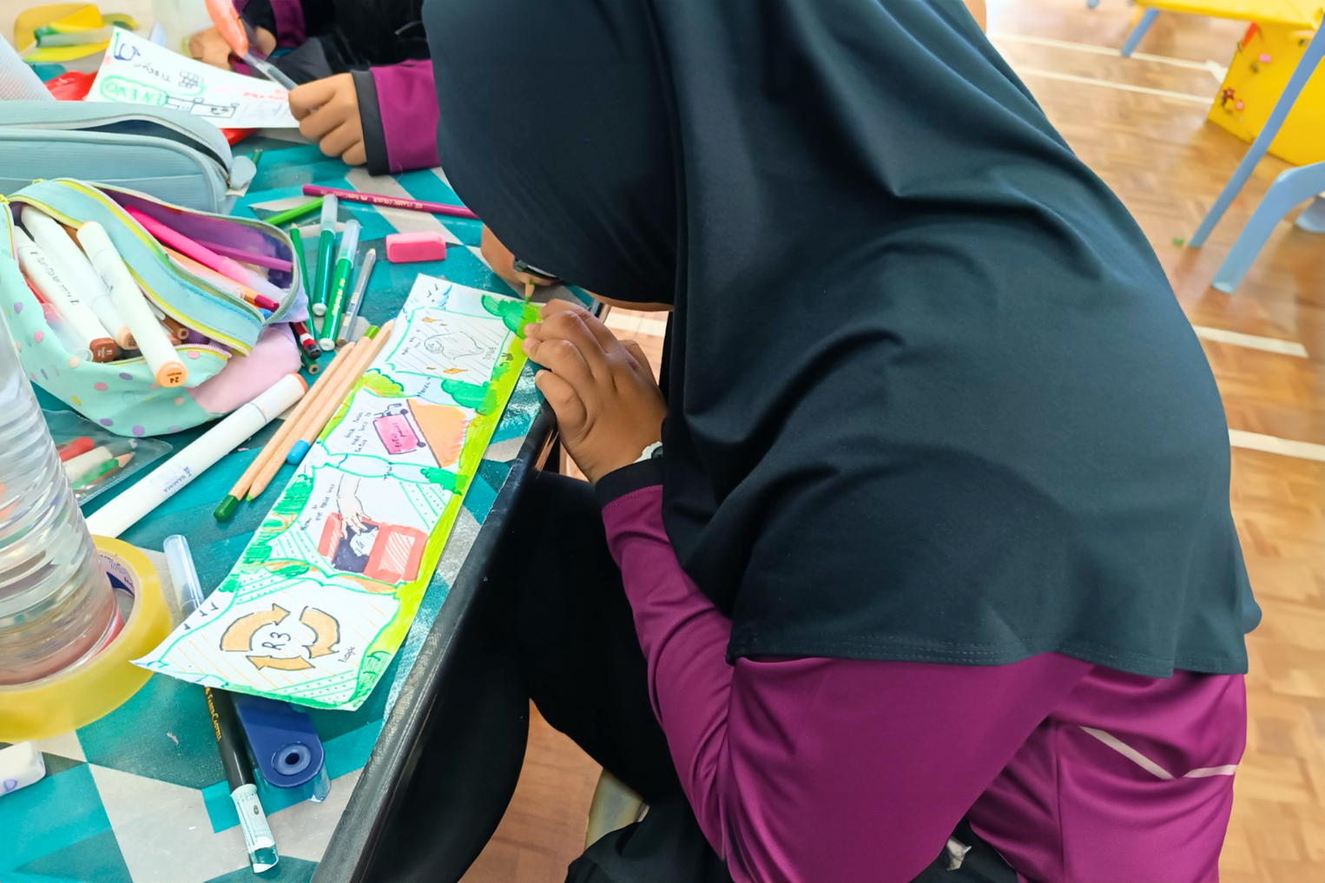
STRATEGIC FRAMEWORK
VISION
Education for a Greener Tomorrow
To create a future where learning empowers people to build a sustainable world.
MISSION
To Educate and Inspire a Generation of Environmentally Responsible Individuals
To inspire responsible learners who lead a greener future through sustainability education and sustainable operations.
04

Slide 7
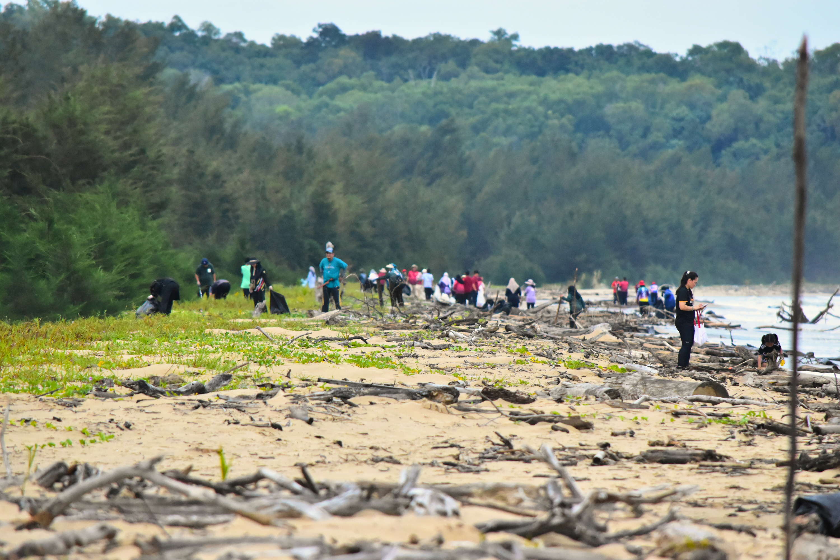
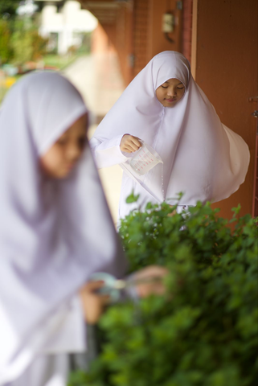
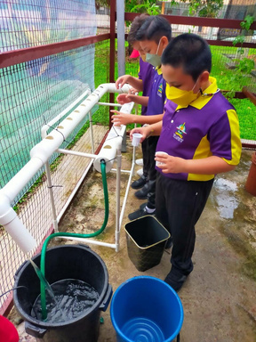
STRATEGIC FRAMEWORK
FOCUS AREA
SUSTAINABILITY EDUCATION
SUSTAINABLE OPERATION
  Embedding environmental topics across the curriculum to build climate awareness.
  Lower costs through sustainable procurement and digital practices.
2. Promoting hands-on learning and green
co-curricular activities.
2. Improve infrastructure for energy efficiency, waste
reduction and resilience.
3. Training educators to deliver effective
environmental education.
3. Adopt renewable energy and green technologies.
4. Supporting research and innovation in
sustainability.
4. Regularly review and update sustainability efforts.
5. Building partnerships with government,
NGOs and international bodies.
05

Slide 8
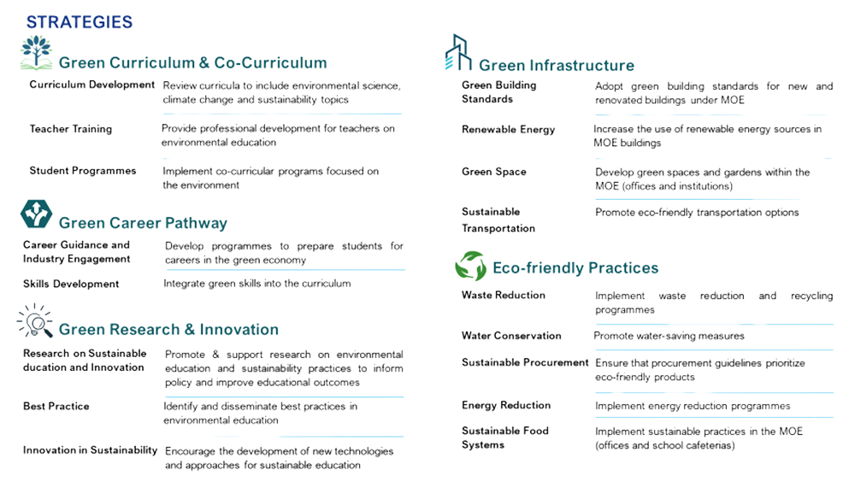
STRATEGIC FRAMEWORK
STRATEGIC PILLARS
GREEN CAREER PATHWAY
  Green Curriculum & Co-Curriculum
  Add sustainability topics to lessons.
  Train teachers in environmental education.
  Run eco-focused co-curricular programmes.
GREEN CURRICULUM &
CO-CURRICULUM
2. Green Career Pathways
  Prepare students for green jobs
(renewable energy, agriculture, green tech).
  Integrate green skills into learning and training.
GREEN RESEARCH & INNOVATION
GREEN INFRASTRUCTURE
4. Green Research & Innovation
  Support research on sustainability in education.
  Share best practices and promote new green technologies.
ECO- FRIENDLY PRACTICES
3. Green Infrastructure
  Build and retrofit schools with eco-friendly standards.
  Use renewable energy and create green spaces.
  Promote sustainable transport options.
5. Eco-Friendly Practices
  Reduce waste, energy and water use.
  Adopt eco-friendly procurement.
  Promote sustainable food systems in schools and institutions.
06

Slide 9


STRATEGIC
FRAMEWORK
CROSS-CUTTING ENABLERS
Capacity Building
Monitoring & Evaluation
Develop the skills and knowledge needed for successful implementation.
Performance Indicators - Develop clear metrics to track progress.
Governance & Finance
Feedback Mechanism - Establish systems for gathering feedback from stakeholders.
Sustainable Funding - Secure long-term funding for environmental initiatives.
Annual Reviews - Conduct annual reviews of the strategic plan.
Resource Allocation - Ensure efficient use of resources for maximum impact.
Stakeholder Engagement & Collaboration
Technology Integration
Strategic Partnership - Build partnerships with local and international organisations and business.
Virtual Learning - Leverage technology for environmental education.
Public Awareness - Raise awareness about environmental issues within the broader community.
Environmental Impact Tracking - Use digital tools to monitor and reduce environmental impact.
Involvement - Encourage parents and community to participate in environmental education initiatives.
07

Slide 10

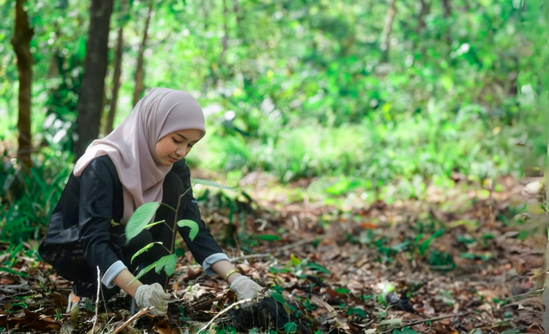
IMPLEMENTATION
STRATEGY
To implement the Greening Education Plan, core strategies have been created to embed sustainability throughout the education system. They aim to drive long-term behaviour change and transform institutions by integrating sustainability into teaching, operations, infrastructure and career development.
GREEN CURRICULUM & CO-CURRICULUM
Sustainability principles are integrated across formal curriculum and co-curricular activities.
This includes:
  Embedding climate and environmental topics in curriculum content.
  Providing professional development for educators.
  Offering students practical, real-world learning opportunities to apply sustainability concepts.
08

Slide 11
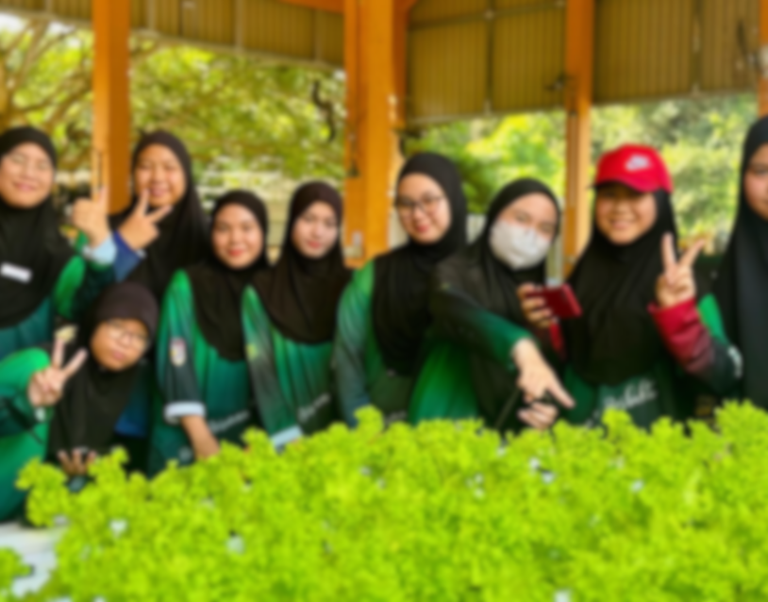
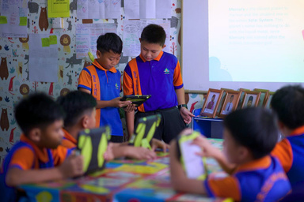
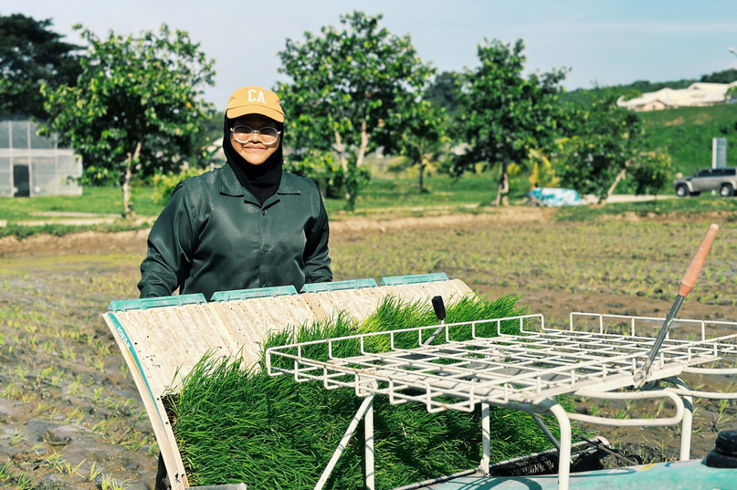
IMPLEMENTATION
STRATEGY
CURRICULUM DEVELOPMENT
Six core sustainability themes:
  Climate Science
  Ecosystems & Biodiversity
  Climate Justice
  Resilience-Building
  Post-Carbon Economies
  Sustainable Lifestyles
STUDENT PROGRAMMES
Environmental action is promoted through co-curricular and
extra-curricular activities such as:
It will be inclusive for all learners, (including those with special needs) have access with higher education embedding sustainability in programmes and research to support the green economy.
  Eco-clubs and school greening projects
  Innovation and climate challenges
  Agri-tech and conservation initiatives
  Sustainability bootcamps and STEAM outreach
These programmes build skills and leadership, supported by
government / NGO partnerships, recognition and incentives.
TEACHER TRAINING
Ongoing professional development will build teachers’ capacity to deliver sustainability education effectively across all levels. This includes:
  Integrating sustainability topics into pre-service and in-service training.
  Facilitating knowledge sharing between schools and higher education institutions.
09

Slide 12
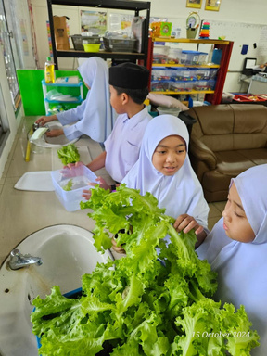
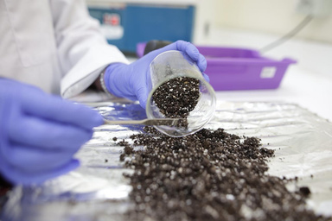
IMPLEMENTATION
STRATEGY
GREEN CAREER PATHWAYS
Education system will support the transition to a green economy by preparing students and existing workers for careers in sustainable sectors (e.g., renewable energy, sustainable agriculture, environmental engineering, eco-innovation).
SKILLS DEVELOPMENT
CAREER GUIDANCE AND INDUSTRY ENGAGEMENT
Sustainability-related competencies (systems thinking, innovation, digital literacy, environmental ethics, etc.) and technical skills (renewable energy systems, waste management, sustainable agriculture) will be embedded into education and training programmers.
Certification, internships, and industry placements will provide practical experience and enhance employability in green sectors. Upskilling initiatives will support current workers to
transition into green jobs.
Career services will raise awareness of green job opportunities and guide students and professionals toward suitable pathways through career talks, mentorships, job fairs and advisory services.
Strong collaboration with industry partners will ensure training remains aligned with evolving labour market needs and supports a future-ready talent pipeline.
100

Slide 13
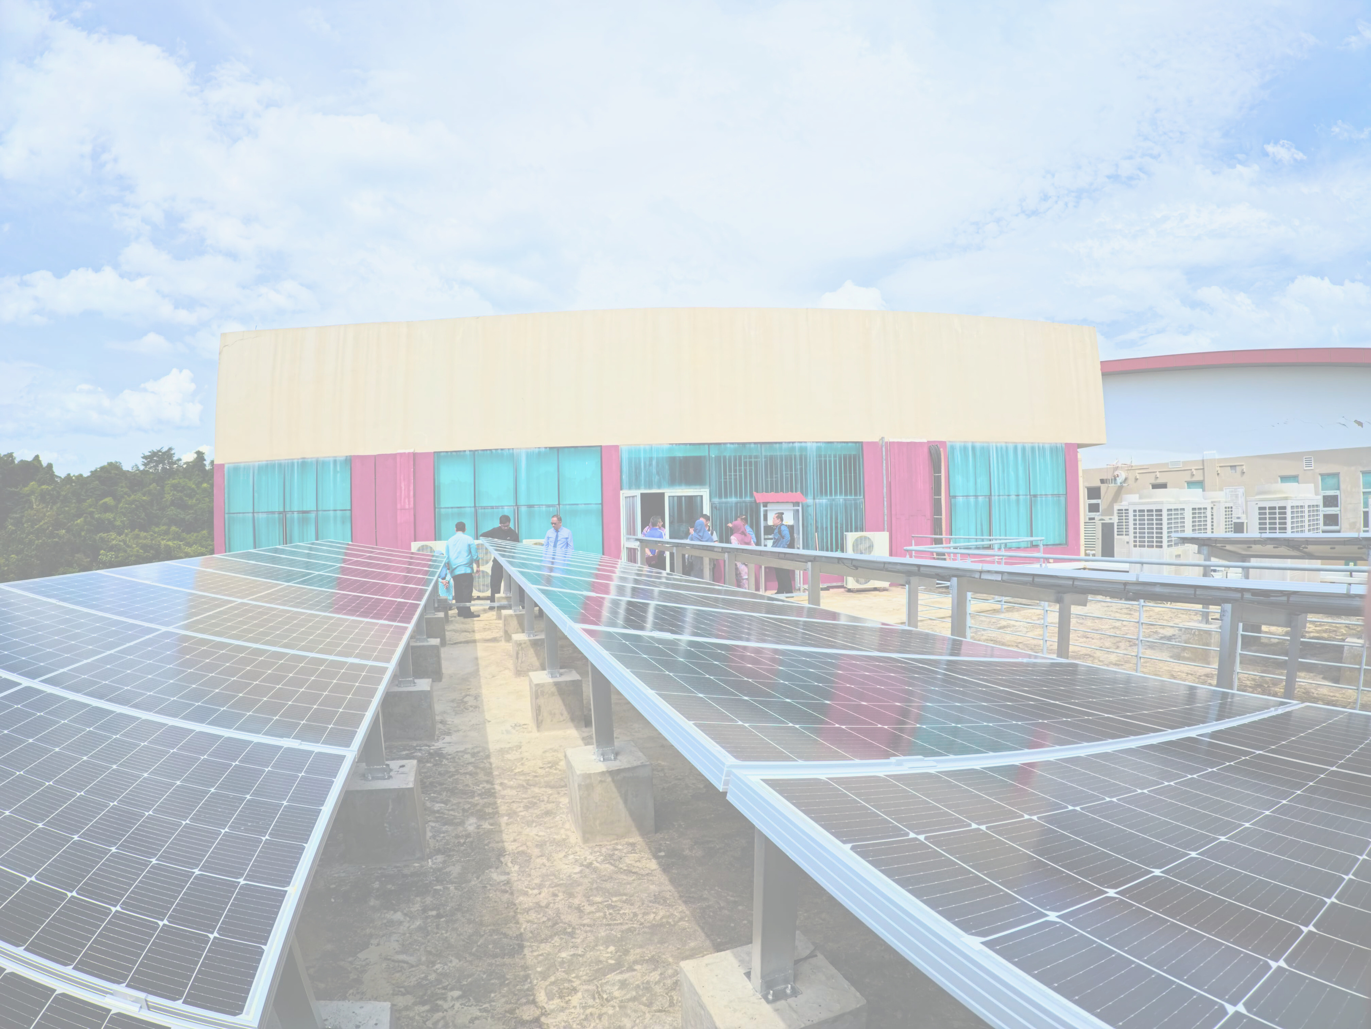
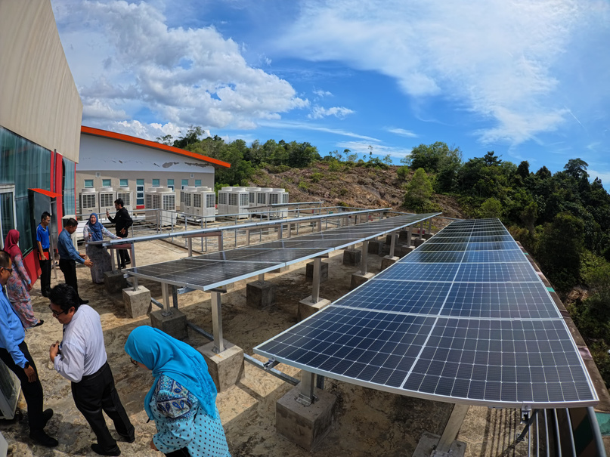
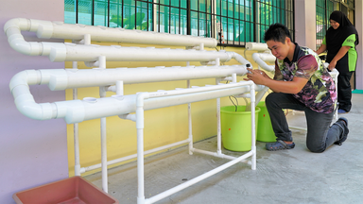
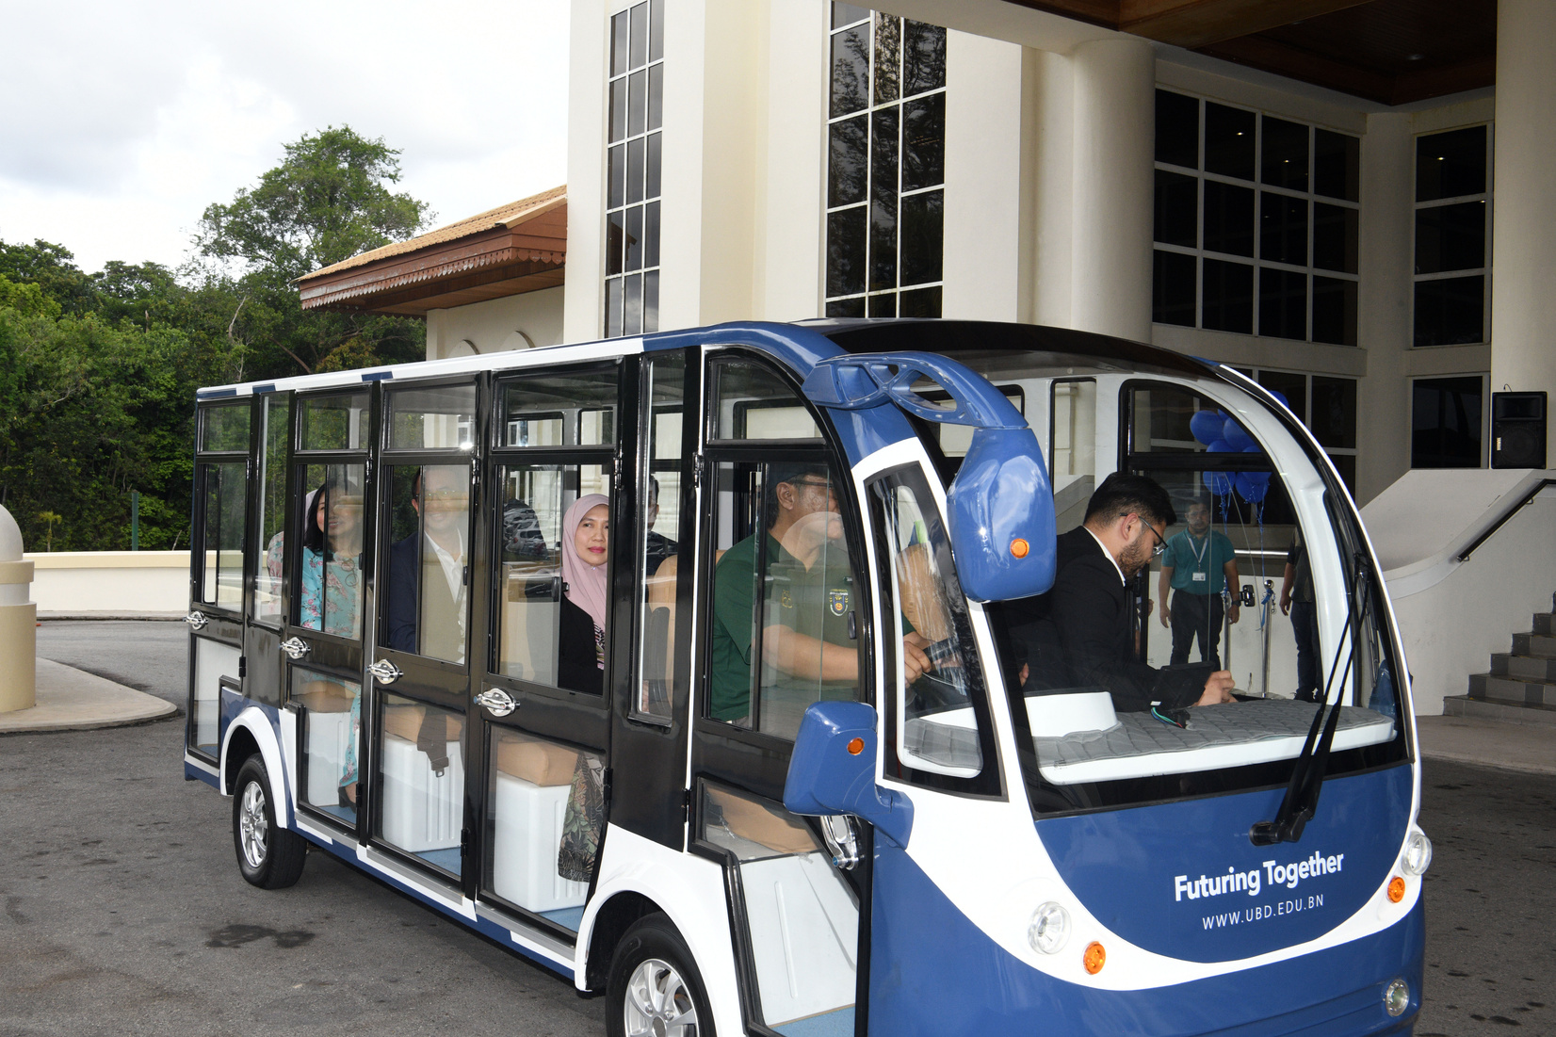
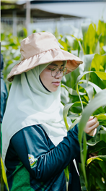
IMPLEMENTATION
STRATEGY
GREEN INFRASTRUCTURE
To create sustainable learning environments, the Ministry will integrate eco-friendly practices into the physical and operational infrastructure of educational institutions. This includes:
GREEN BUILDING STANDARDS
RENEWABLE ENERGY
All new and renovated facilities will follow green standards focused on energy efficiency, water conservation, sustainable materials, and better indoor air quality. Existing facilities will be progressively upgraded to meet national sustainability benchmarks.
Increased use of solar and other renewable energy systems to lower emissions and serve as hands-on learning tools for students.
SUSTAINABLE TRANSPORTATION
GREEN SPACE
Promote walking, cycling and shared transport through supportive infrastructure (safe walkways, bike racks, drop-off zones) to reduce carbon emissions and promote healthy lifestyles.
Development of school gardens, urban farms and biodiversity zones to support ecological education, enhance well-being and adapt to climate change using sustainable landscape practices.
11

Slide 14
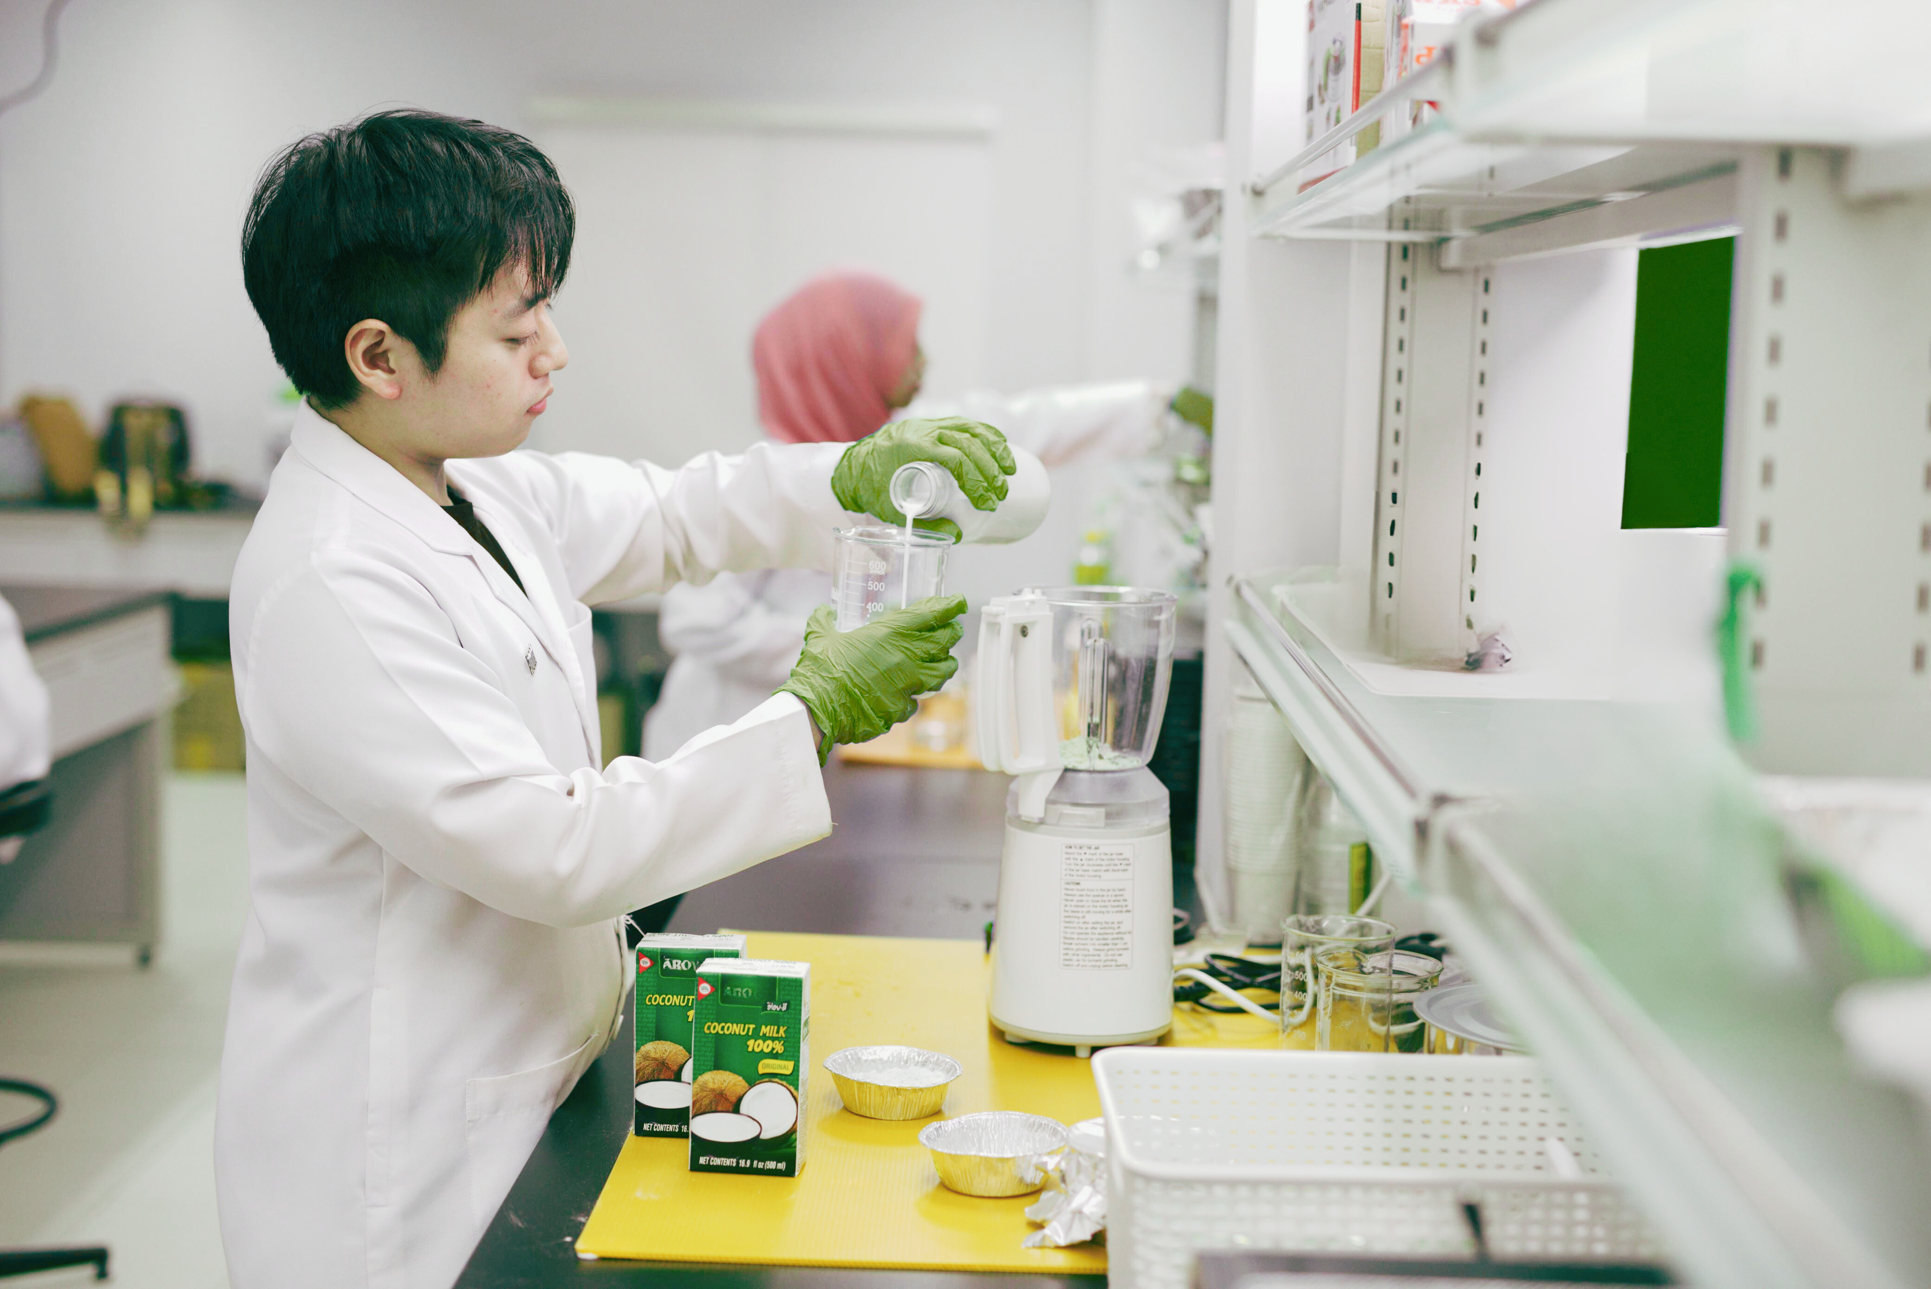
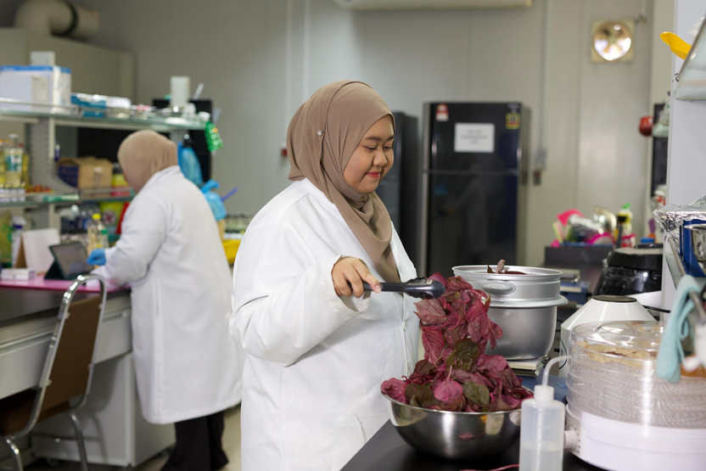
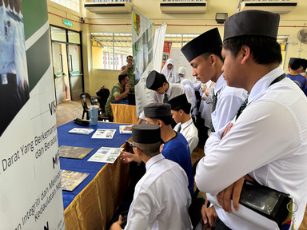
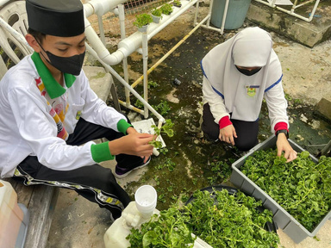
RESEARCH AND INNOVATION
IMPLEMENTATION STRATEGY
PURPOSE:
Strengthen environmental education through evidence-based practices, applied research and innovative solutions across the education sector.
RESEARCH FOR SUSTAINABLE EDUCATION & INNOVATION
BEST PRACTICES
  Research ways to improve sustainability teaching, curriculum and policy.
  Study behaviour change and effective models for environmental literacy.
  Support green tech research for Brunei’s low-carbon goals.
  Build partnerships between schools, universities and industry to apply research in practice.
  Use inquiry-based, project-based and interdisciplinary learning.
  Implement whole-school sustainability (green campuses, energy saving, community projects).
  Share best practices via conferences, online platforms and recognition programmed.
INNOVATION IN SUSTAINABILITY
  Use tech and innovation (AI, virtual tools, simulations) to boost sustainability learning.
  Support student-led projects through green challenges, hackathons and eco-startups.
  Develop smart green campuses with waste reduction, carbon audits and eco-mobility.
  Provide grants and pilots with industry/government to create local SDG solutions.
12

Slide 15

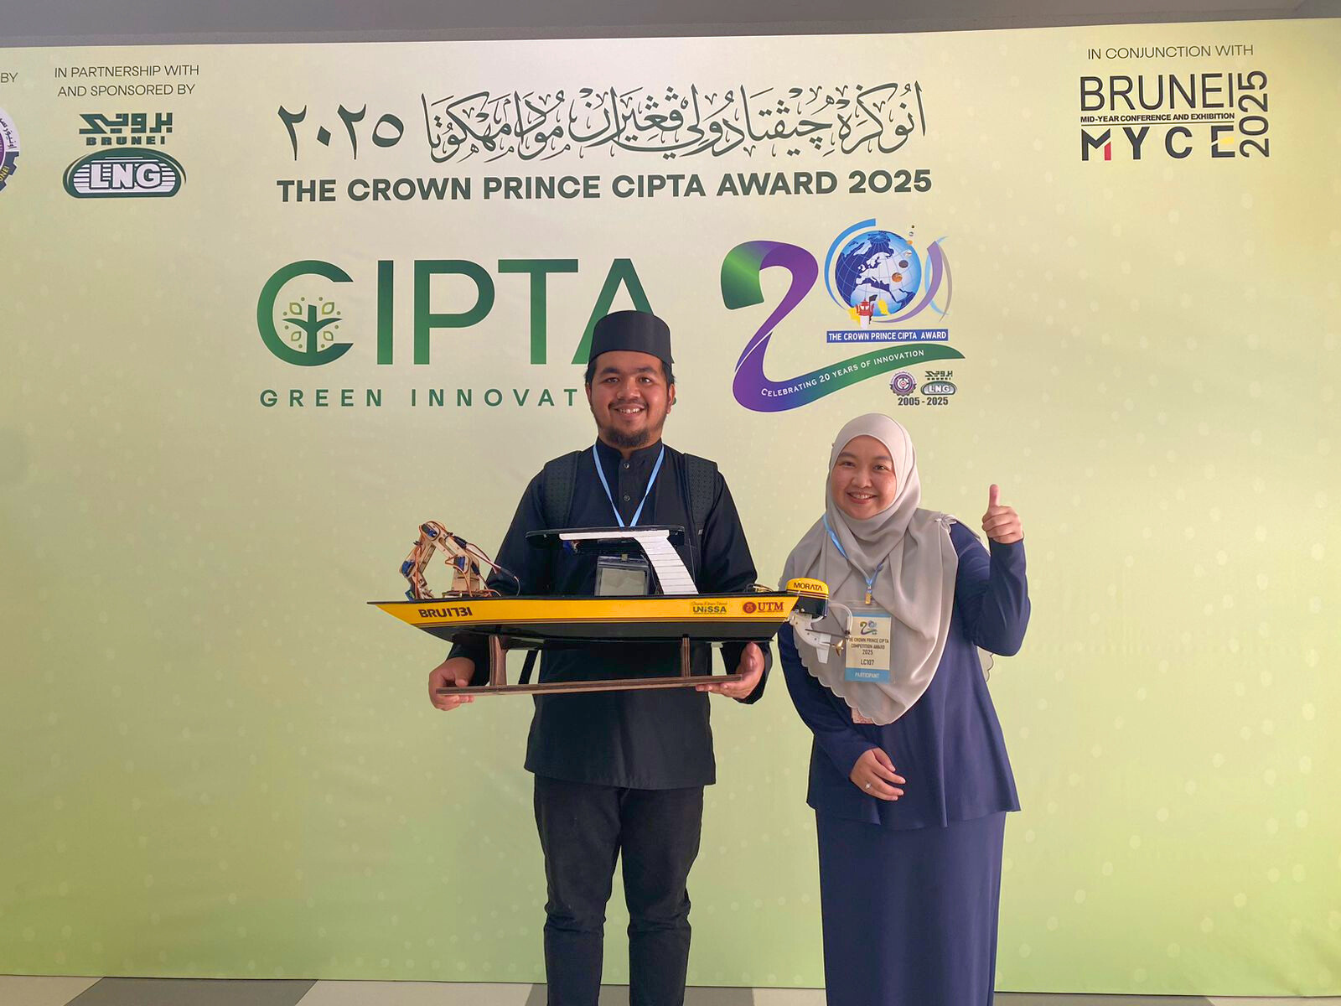
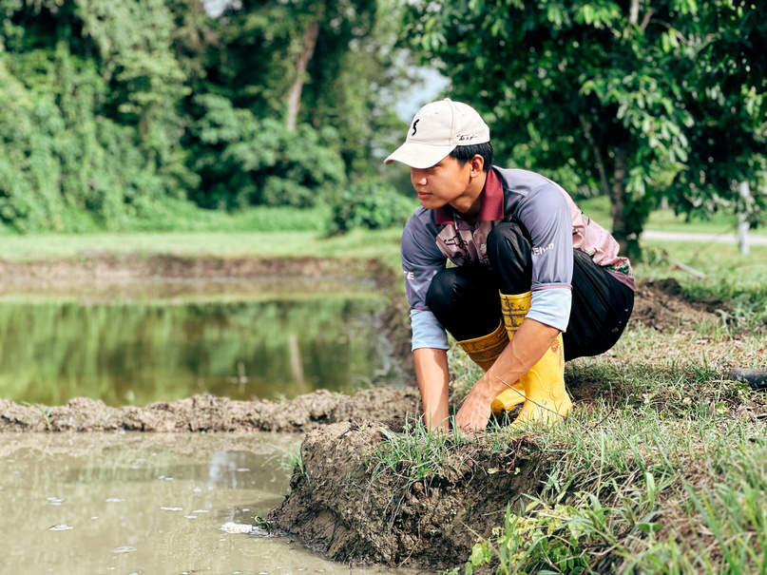
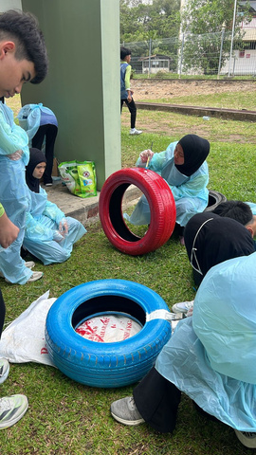
ECO-FRIENDLY PRACTICES
IMPLEMENTATION STRATEGY
WATER REDUCTION
  Recycling stations in schools and offices.
  Reduce single-use plastics and paper.
  Teach students and staff about recycling.
  Universities: research and student projects on waste solutions.
  Ministry: go paperless and adopt green procurement.
ENERGY REDUCTION
  Switch to LED lights, smart sensors and efficient appliances.
  Encourage turning off unused devices and using natural ventilation.
  Regular energy audits.
  Use solar power where possible.
  Track energy use in real-time for accountability.
SUSTAINABLE PROCUREMENT
  Buy eco-friendly, recyclable and non-toxic products.
  Use energy-saving equipment.
  Source locally to cut transport emissions.
  Work with suppliers who have green certifications.
SUSTAINABLE FOOD SYSTEMS
WATER CONSERVATION
  Support local farmers and buy organic produce.
  Reduce food waste and single-use plastics.
  Promote school gardens for fresh food and learning.
  Compost food waste and donate extra food.
  Install water-saving taps and toilets.
  Use rainwater for gardens and cleaning.
  Run awareness campaigns to save water.
  Fix leaks quickly and monitor water use.
13

Slide 16
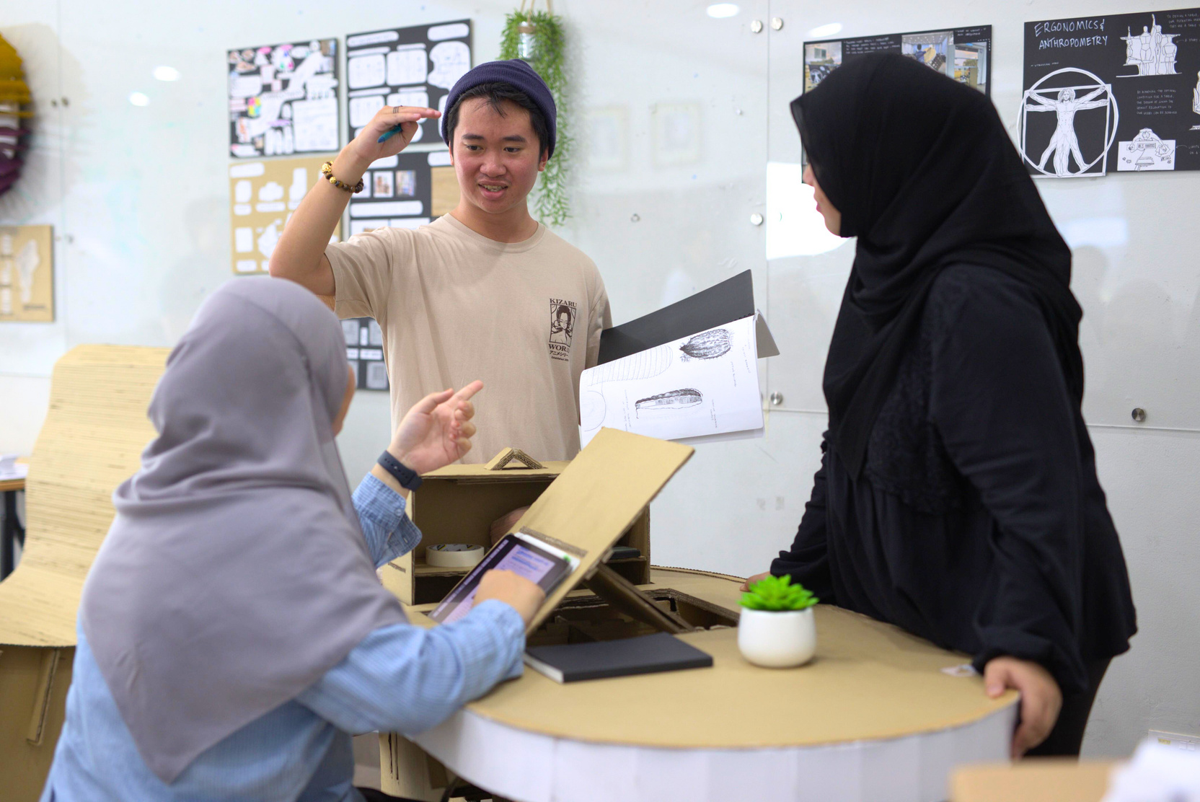
KEY ENABLERS
CAPACITY BUILDING
To make the plan successful, 5 main enablers are needed. These work together to build a strong, future-ready and sustainable education system.
Train teachers, school leaders and ministry staff on sustainability.
Involves communities to create a shared culture of sustainability.
Support schools with funding, infrastructure and expertise.
Empower administrators to lead whole-school eco changes.
Provide green teaching materials and professional development.
14

Slide 17
KEY ENABLERS
MONITORING AND EVALUATION
PERFORMANCE INDICATORS
FEEDBACK MECHANISM
1
2
Track progress in key areas:
  Sustainability in curriculum.
  Green infrastructure in schools.
  Teacher training.
  Student participation.
  Environmental outcomes.
  Measure energy efficiency (lower utility costs, more renewable energy use).
  Track green careers (students in sustainability-focused programmes, TVET, higher education).
  Monitor research & innovation (number and quality of eco-projects).
  Assess eco-friendly operations (waste reduction, recycling, paperless systems, sustainable procurement).
  Collect input from students, teachers, parents, school leaders and communities.
  Use surveys, focus groups and engagement sessions.
  Feedback helps the Ministry adjust programmes in real time.
  A Taskforce or Working Group will coordinate, analyse trends and ensure stakeholder voices are heard.
ANNUAL REVIEWS
3
Conduct yearly reviews to:
  Check progress and identify challenges.
  Improve strategies and resource use.
  Stay aligned with Brunei’s national sustainability goals.
  Led by the Taskforce, which prepares reports and recommendations.
15

Slide 18
KEY ENABLERS
STAKEHOLDERS ENGAGEMENT & COLLABORATION
To build a culture of sustainability, the Greening Education Plan involves all stakeholders families, schools, communities, government and the private sector. It promotes a whole-of-nation approach with regular communication and cross-sector partnerships, embedding sustainability values in schools, homes, workplaces and the wider community. The goal is shared responsibility and greater impact.
1
INVOLVEMENT
Parents are key partners in shaping eco-conscious students.
Activities include:
  Environmental workshops.
  Home-based green practices.
  Family events (tree planting, clean-ups).
  Regular school updates on green efforts.
  Strong school-home partnerships reinforce values beyond classrooms.
16

Slide 19
KEY ENABLERS
2
STRATEGIC PARTNERSHIP
  Work with local businesses, NGOs, community groups and government regulators.
  Provide resources, expertise, mentorship and real-world learning.
  Collaborate internationally to exchange best practices and align with global sustainability goals.
  Partnerships will be formal and long-term, ensuring mutual benefit.
3
PUBLIC AWARENESS & ENGAGEMENT
  Use campaigns, media and community activities to raise awareness.
  Examples: national eco-events, competitions, social media campaigns.
  Recognise student and school achievements to inspire others.
  Builds public trust and positions Brunei as a leader in sustainability education.
17

Slide 20
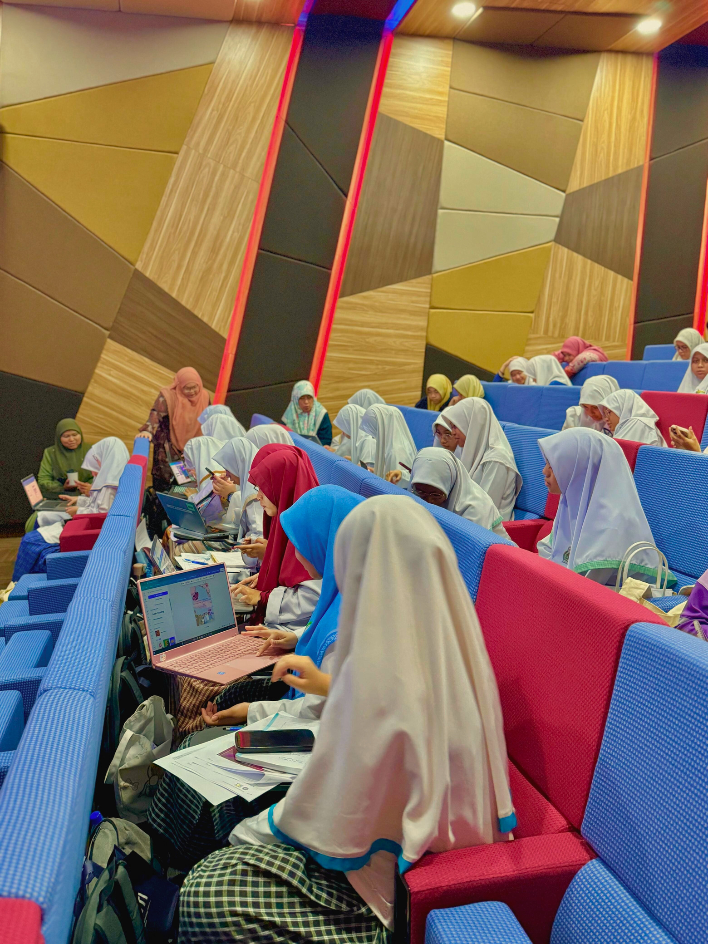
KEY ENABLERS
TECHNOLOGY INTEGRATION
Technology plays a big role in making education greener, smarter and more efficient. It supports learning, monitoring and decision-making across schools and institutions.
VIRTUAL LEARNING
ENVIRONMENTAL
IMPACT TRACKING
EXPLORING SMART
SYSTEMS & DATA USE
1
2
3
  Use online platforms, apps and games to teach environmental topics.
  Create digital libraries for green resources.
  Encourage collaboration between schools on eco-projects.
  Build students’ digital literacy and sustainability skills so they become responsible digital citizens.
  Explore smart infrastructure and advanced analytics to manage resources efficiently.
  Upgrade existing dashboards with real-time green indicators.
  Use data to make schools future-ready, sustainable and high-performing.
Use digital tools to monitor:
  Energy use ⚡
  Water use 💧
  Waste generation 🗑️
  Carbon footprint 🌍
It can help schools set targets, track performance and train students in awareness and responsibility through a central reporting system.
18

Slide 21
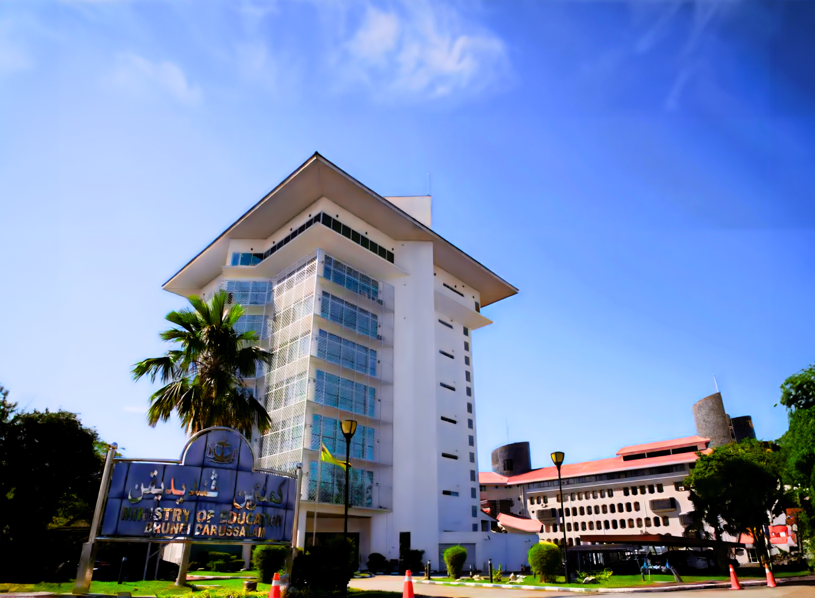
KEY ENABLERS
GOVERNANCE & FINANCE
Good governance and sustainable funding are the backbone of the Greening Education Plan. They ensure policies, leadership and money are in place to make the plan successful long-term.
POLICY FRAMEWORKS AND LEADERSHIP
SUSTAINABLE FUNDING
RESOURCE ALLOCATION & INCENTIVES
1
2
3
Funding will come from government, green financing, grants and private sector contributions.
Priority areas:
  Renewable energy.
  Green infrastructure.
  Teacher training & capacity building.
  Awareness programmers.
  Use public-private partnerships (PPPs) to pool resources and expertise.
  Focus on long-term cost-efficiency and environmental impact.
Resources will be used strategically for maximum impact.
Focus areas:
  Green infrastructure.
  Environmental research & innovation.
  Teacher training.
  Cross-sector sustainability education.
  Provide incentives and grants for schools/universities leading in green innovation.
  Ensure cost-effective strategies and strong financial management.
  Strong policies will guide planning, curriculum, infrastructure and operations.
  A Greening Education Taskforce will oversee, coordinate and monitor progress.
  Each institution will have a sustainability focal point to lead and report green actions.
  Governance will be inclusive, involving government, NGOs, private sector and communities.
19

Slide 22


FOR FURTHER INFORMATION
SCAN THE QR CODE FOR THE eBOOK

